Slide 2
Digital Forensics Lecture-26
By- Dr.subhranil Das
Assistant Professor
School of computer Science

Slide 3

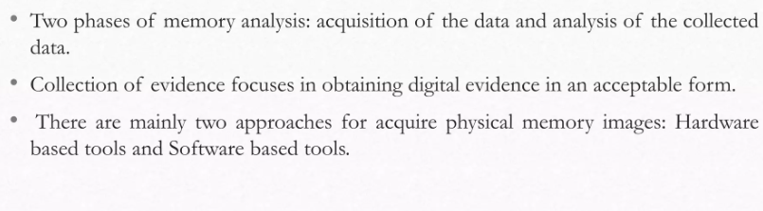
Tools and Techniques

Slide 4
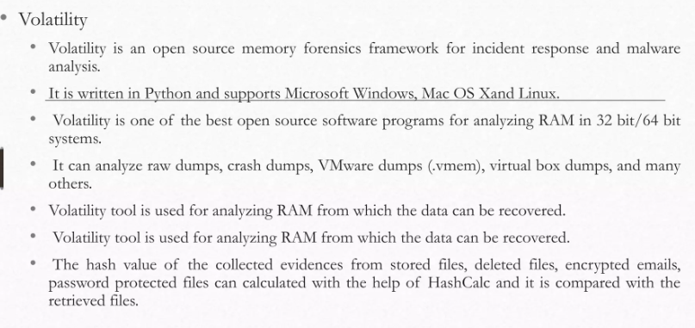
Volatility

Slide 5
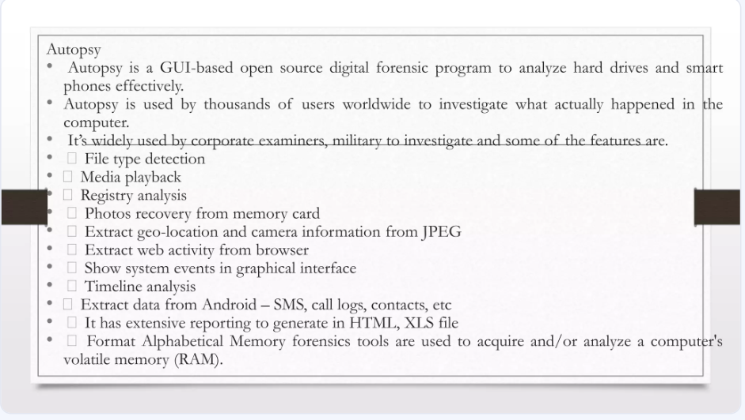
Autopsy

Slide 6
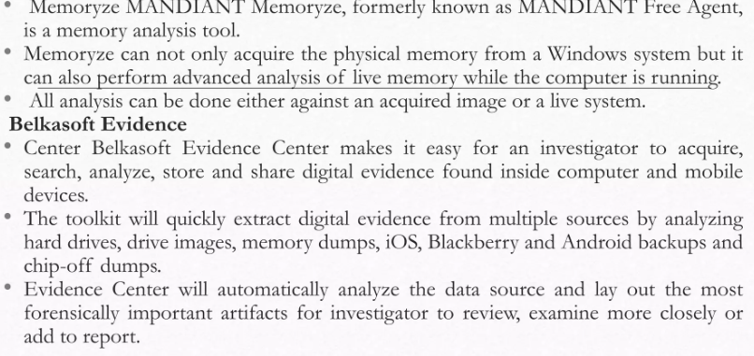
MADIANT

Slide 7
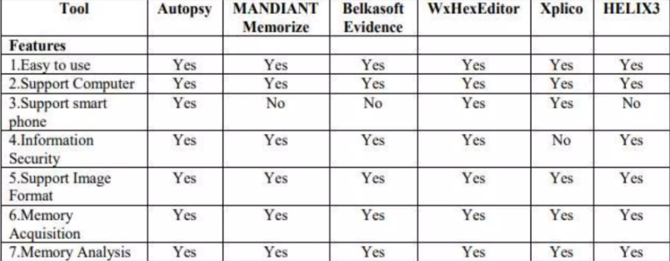
Comparison of different tools

Slide 8
Next Lecture
Unit -4
.

